Slide 1
Design of Upper-body exoskeleton with Multifilament muscle actuation and Biomimetic Support
Authors :Soorya Narayanan, Rahul KS , Hyder Mundoly, Arshed Ahmed , Sandip Rudha Budhe ,Gangadhara Kiran Kumar

Slide 2
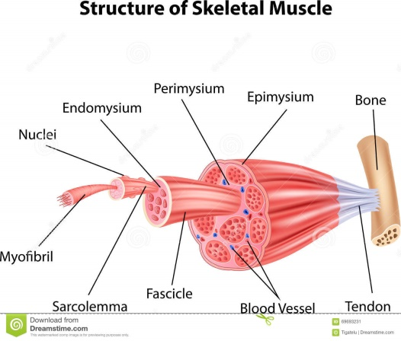
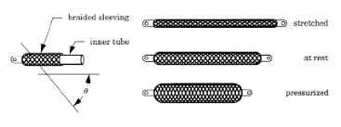
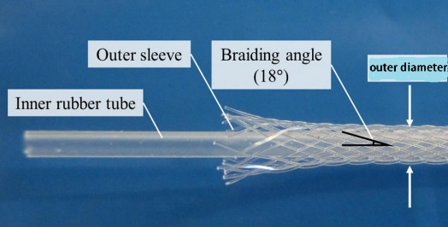
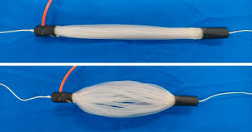
Introduction
These are smaller McKibben muscles that work on pneumatic actuation.
Main parts:
Inner tube
OD=4.34 mm
ID=3 mm
Outer Sleeve
OD=0.4 mm

Slide 3
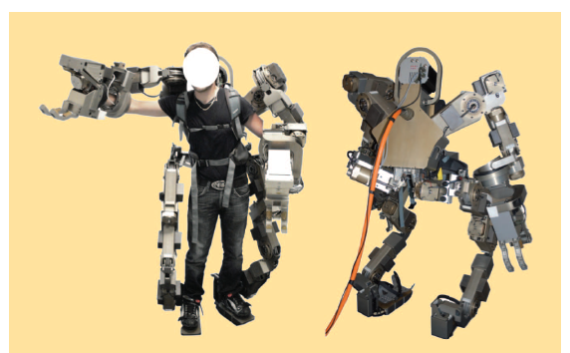
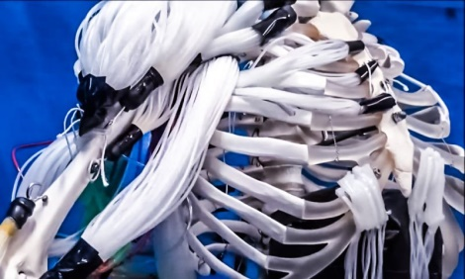
Problem Definition
PAMs are used usually in Exosuits ; these are sturdy & provide heavy forces but compromise on flexibility
To tackle this we use thin Mckibben bundles called Multifilament muscles
These muscles have been tested to replicate human-like motions in certain robotic designs
This paper tries to conceptualize the use of such muscles in an Exo-suit to obtain force augmentations

Slide 4
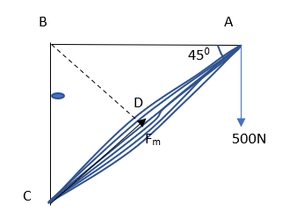
Theoretical Methodology
Mathematical model
F=5.0705x10⁻⁴ (P-P_{th}) -5.006x10⁻¹⁰ (P-P_{th})² -7.3828x10⁻¹⁶ (P-P_{th})³
P_{app} =0.7MPa
P_{th} = 0.1441MPa
Braid angle = 18º
Bicep Muscles
Number of muscles = 16
L= 200 mm
F_{m}= 500 N
F_{single} = 500/16 = 31.25 N
P = 0.652624MPa
Back Muscles
Number of muscles = 22
L= 217.0817 mm
F_{m} = 500/sin45 = 707.10672 N
F_{single=} 707.10672/22 =32.14 N
P = 0.6510683MPa

Slide 5
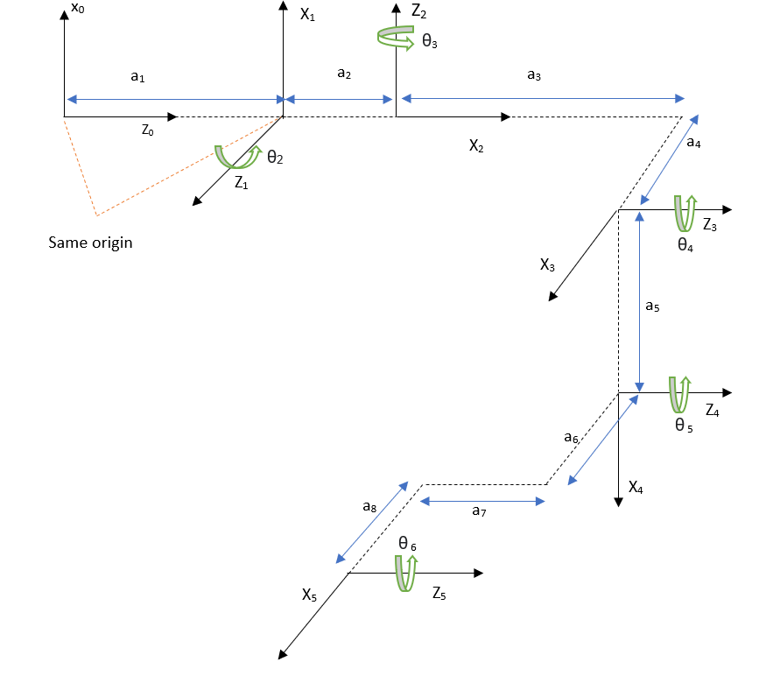
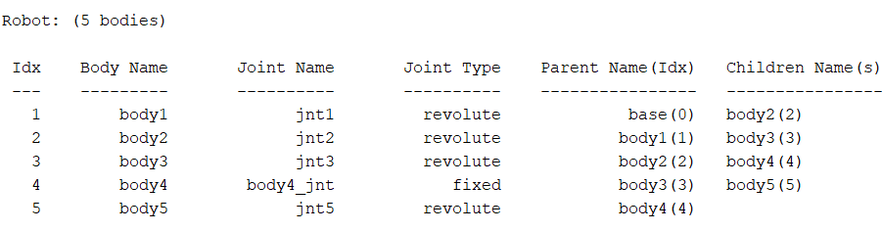
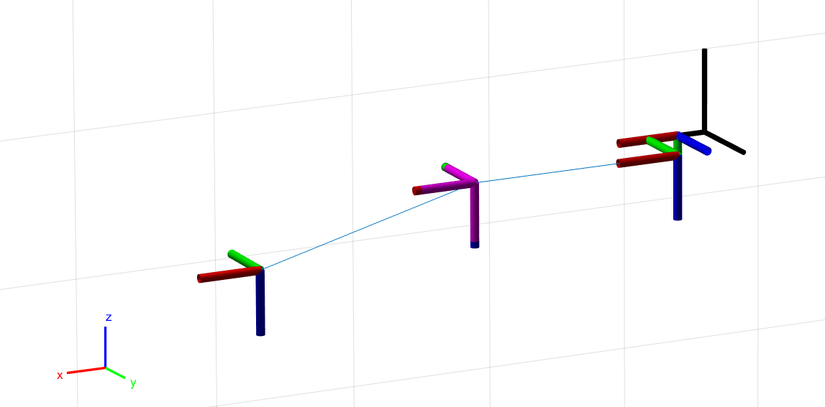
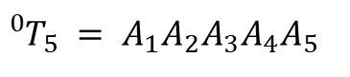
Dynamic Modelling
Kinematic Modelling
DH parameterization
Rigidbodytree creation
$${}_{ }^{0}{T_{5}} = A_{1}A_{2}A_{3}A_{4}A_{5}$$

Slide 6
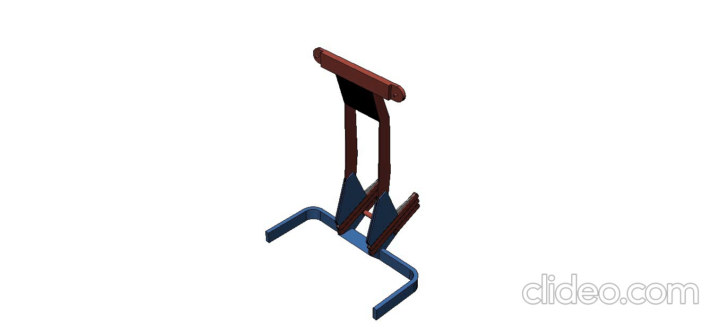
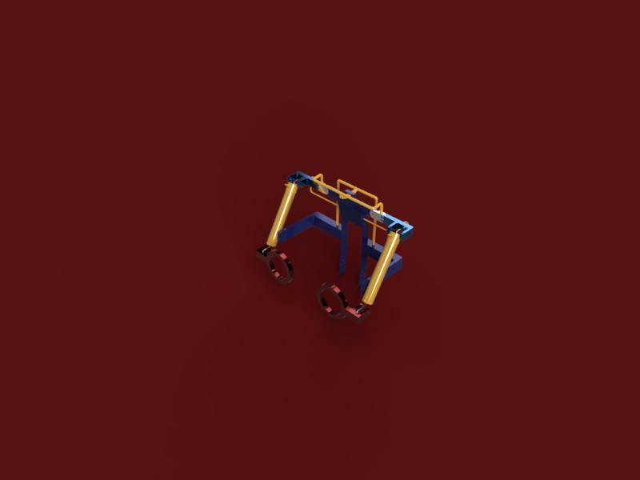
Mechanical Design & Assembly
Four complexes
Back Complex
Shoulder Complex
Elbow Complex
Upper Limb part
Elbow Joint
Forearm Part
Hand Complex
Muscle complexes (yellow)
Elbow Muscles
Shoulder Muscles

Slide 7
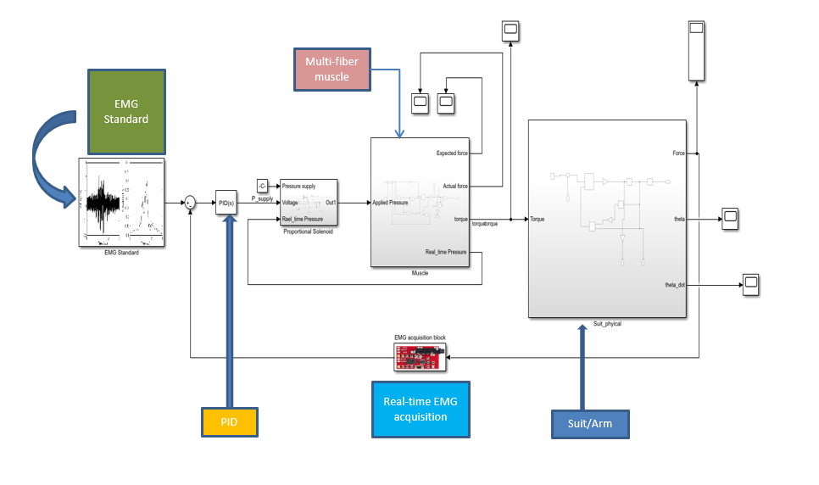
Sensing & Control
Overall System Control Block:

Slide 8
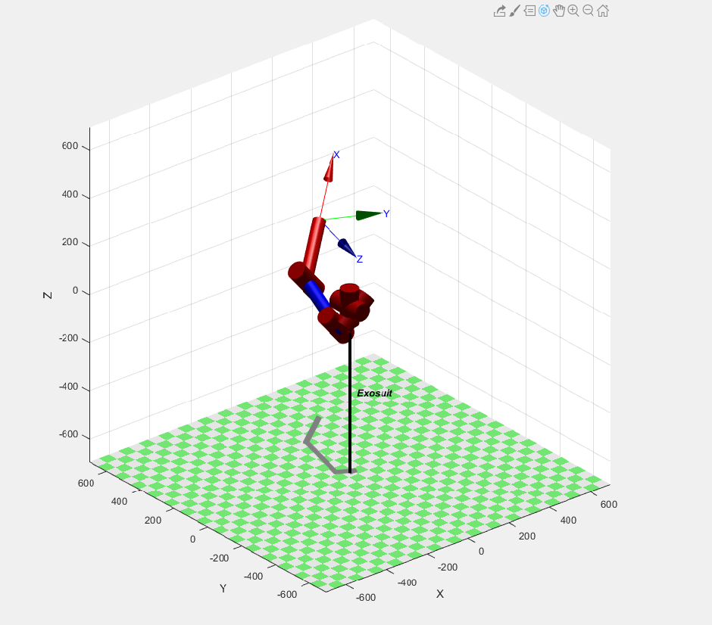
Results and Discussion
1. Mathematical modelling:
The observed actual force is less than theoretical force – due to “dead space”
2. Kinematic and dynamic modelling:
Dynamic modelling was done using MATLAB robotic system toolbox using DH parameters and transformations
Forward and inverse dynamic analysis were obtained using the inbuilt functions in MATLAB

Slide 9
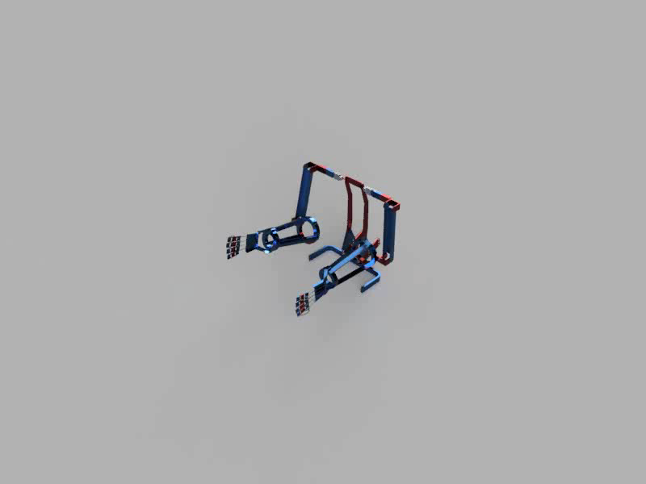
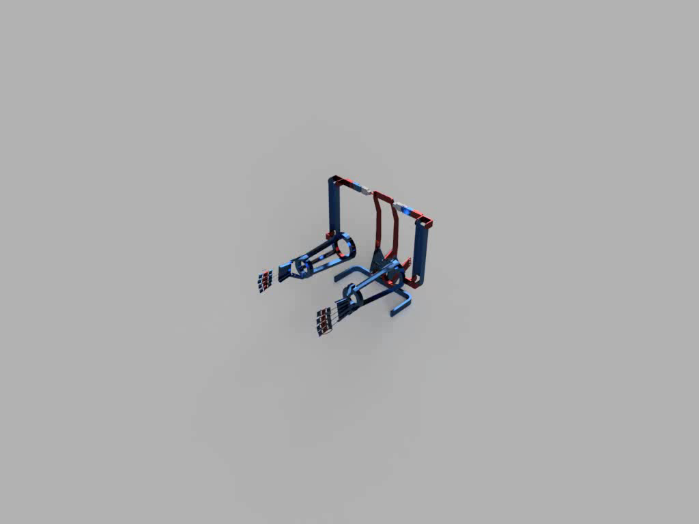
Motion Analysis
Shoulder
Elbow

Slide 10
3. Mechanical design:
Variation of FOS w.r.t Load

Slide 11
Variation in Stress w.r.t Load
Stress-Strain Curve of the suit

Slide 12
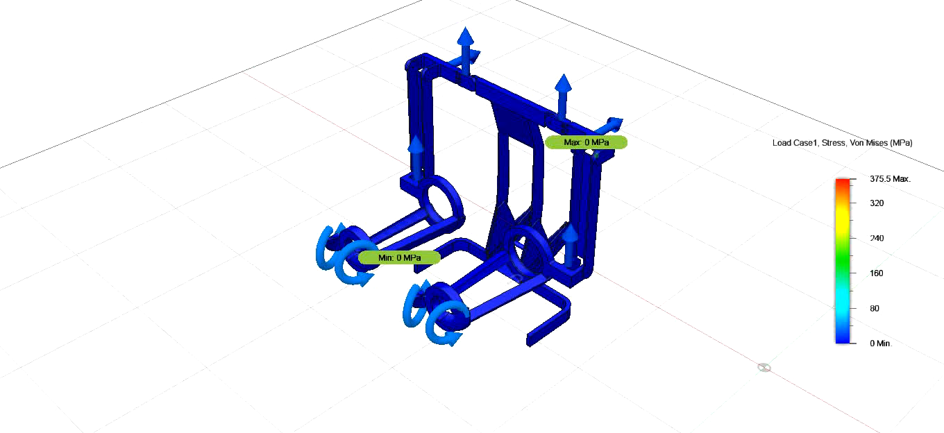
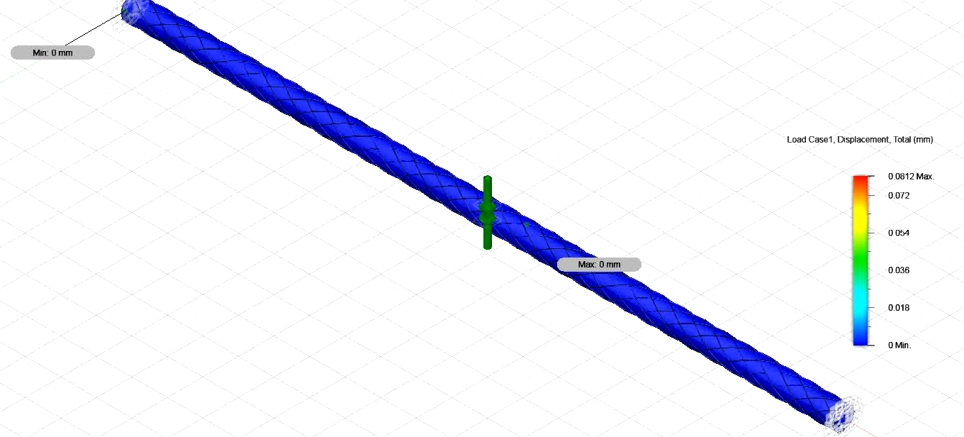
Simulation of Exoskeleton
Simulation of Mckibben Fibre
Minimum Factor of Safety = 2.356
Maximum Displacement observed in a single Fibre is 60 microns

Slide 13
4. Sensing & Control :
EMG acquisition test : Used to standardize muscle pattern
Commercial gel electrodes were used which has noise in the input signal. Clinical EMG test will give more accurate results
Control of the suit was done using a PID model with a proportional valve
Control variable here is the spool position
A memory block can be added to counteract any overloads created
As a safety precaution , include deadman’s switch

Slide 14
Conclusion
The concept of dead space present during bundling of fibres reduce the expected force received.
Although multiple EMG tests were conducted, the absence of precision sensors in turn affects the control of the suit. However, using proper AgCl coated electrodes have been seen to tackle this issue fairly.
The use of an AFC control would have been able to tackle the noises that arise from the inputs as well as during the working cycle.
Although the use of a proportional solenoid valve gives better control, the price of such an apparatus much higher than the conventional directional valves and increases complexity.

Slide 15
Scope for future work
Better design of individual strands and modification of dead space
Adding more bundles to represent each muscle sector
Providing a dense energy source to the suit
The biggest challenge for precision control is precise input acquisition
Inclusion of ML and/or AI
Experiments can be done conducted to improve the utility range of use of the suit

Slide 16
References
Shunichi Kurumaya, Hiroyuki Nabae, Gen Endo, “Design of thin McKibben muscle and multifilament structure”. Koichi Suzumori Department of Mechanical Engineering, Tokyo Institute of Technology, 2-12-1 Ookayama, Meguro-ku, Tokyo 152-8552, Japan.
INTRODUCTION TO ROBOTICS ANALYSIS, CONTROL, APPLICATIONS, Second Edition, Saeed Benjamin Niku, Ph.D., P.E. Professor Mechanical Engineering Department California Polytechnic State University San Luis Obispo
Wan Hasbullah Mohd Isa1, Zahari Taha1, Ismail Mohd Khairuddin1, Anwar P.P. ,” An intelligent active force control algorithm to control an upper extremity exoskeleton for motor recovery “ , IOP Conf. Series: Materials Science and Engineering 114 (2016) .
Madeeha Majeed, Khurram Butt, Salman Qureshi, Bilal Majeed, 2013, “Design and Control of Low- Cost Portable EMG Driven Exoskeleton Device for Human Wrist Rehabilitation”, INTERNATIONAL JOURNAL OF ENGINEERING RESEARCH & TECHNOLOGY (IJERT) Volume 02, Issue 10 (October 2013).
A. Salman, J. Iqbal, U. Izhar, U. S. Khan and N. Rashid, "Optimized circuit for EMG signal processing," 2012 International Conference of Robotics and Artificial Intelligence, Rawalpindi, 2012 IEEE.
Amirul Syafiq Sadun, Jamaludin Jalani, Jumadi Abdul Sukor, and Faizal JamiL,”Force Control for a 3-Finger Adaptive Robot Gripper by using PID Controller “, Department of Electrical Engineering Technology, Universiti Tun Hussein Onn Malaysia.

Slide 17
THANK YOU

